Slide 1

APEX INSTITUTE OF TECHNOLOGY
DEPARTMENT OF COMPUTER SCIENCE & ENGINEERING
Computer Organization & Architecture (21CSH-281)
Faculty: Siddharth Kumar (E12853)
Lecture - 5
Instruction set architecture of a CPU: Registers
DISCOVER . LEARN . EMPOWER

Slide 2
Computer Organization & Architecture: Course Objectives
COURSE OBJECTIVES
The course aims to:
The purpose of the course is to introduce principles of computer organization and the basic architectural concepts.
It begins with basic organization, design, and programming of a simple digital computer and introduces simple register transfer language to specify various computer operations.
Topics include computer arithmetic, instruction set design, microprogrammed control unit, pipelining and vector processing, memory organization and I/O systems, and multiprocessors.
To familiarize Students with the detailed Architectures of a Central Processing Unit.
Learn the different types of serial communication techniques.

Slide 3
COURSE OUTCOMES
On completion of this course, the students shall be able to:-
CO1 | Identify and interpret the basics of instruction sets and their impact on the design, organization, and functionality of various functional units of a computer comparable to the CPU, memory organization, I/O organization, and parallel processors.
CO2 | Analysis of the design of arithmetic & logic unit and understanding of the fixed point and floating-point arithmetic operations.
CO3 | Relate cost performance and design trade-offs in designing and constructing a computer processor which includes memory.
CO4 | Understanding the different ways of communicating with I/O devices and standard I/O interfaces.
CO5 | Implementation of control unit techniques and the concept of Pipelining.

Slide 4
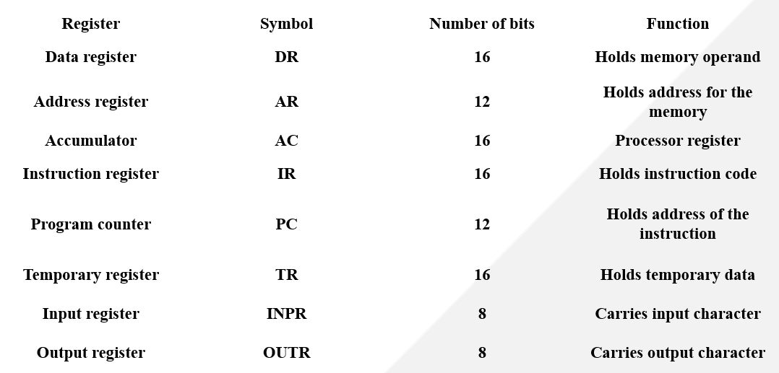
Computer Registers
Registers are a type of computer memory used to quickly accept, store, and transfer data and instructions that a being used immediately by the CPU. The registers used by the CPU are often termed as Processor registers. A processor register may hold an instruction, a storage address, or any data (such as bit sequence or individual characters). The computer needs processor registers for manipulating data and a register for holding a memory address. The register holding the memory location is used to calculate the address of the next instruction after the execution of the current instruction is completed. Following is the list of some of the most common registers used in a basic computer:

Slide 5
The Memory unit has a capacity of 4096 words, and each word contains 16 bits.
The Data Register (DR) contains 16 bits which hold the operand read from the memory location.
The Memory Address Register (MAR) contains 12 bits which hold the address for the memory location.
The Program Counter (PC) also contains 12 bits which hold the address of the next instruction to be read from memory after the current instruction is executed.
The Accumulator (AC) register is a general purpose processing register.
The instruction read from memory is placed in the Instruction register (IR).
The Temporary Register (TR) is used for holding the temporary data during the processing.
The Input Registers (IR) holds the input characters given by the user.
The Output Registers (OR) holds the output after processing the input data.

Slide 6
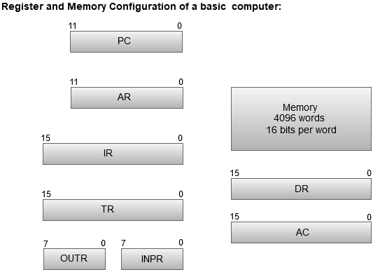
The following image shows the register and memory configuration for a basic computer.

Slide 7
Summary
Discussed about Computer Registers.
Assessment Questions
Q1. Describe the difference between shift register and counter.
Q2. How data is transferred in the shift register?
Q3. Explain the term : Single bit register and register
Q4. Describe the function of shift register.
Q5. Describe the meaning of SH and LD at the input of the shift register?
Q6. What is universal shift register?

Slide 8
THANK YOU

